Slide 1







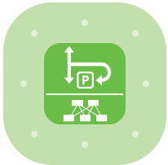
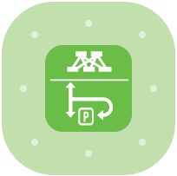













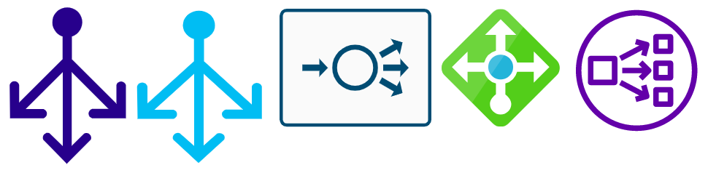


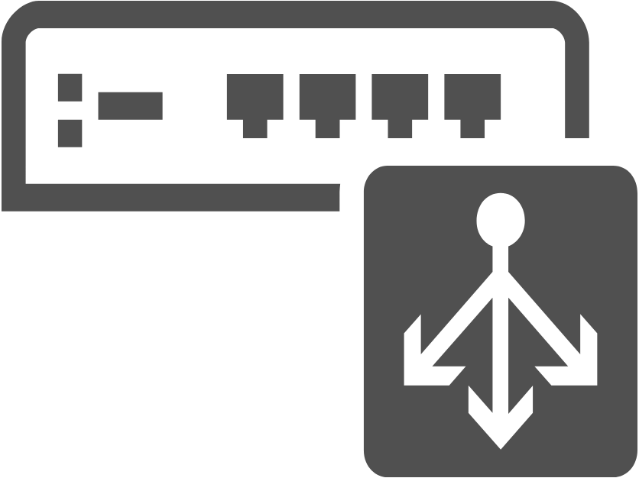





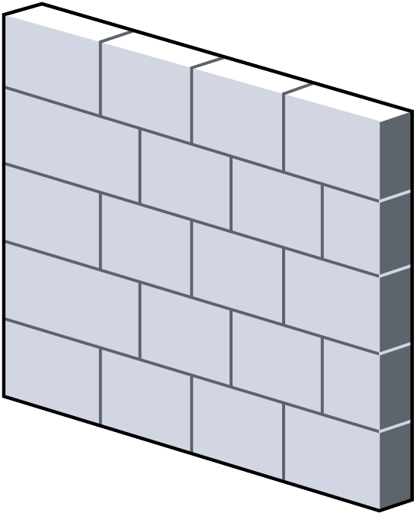


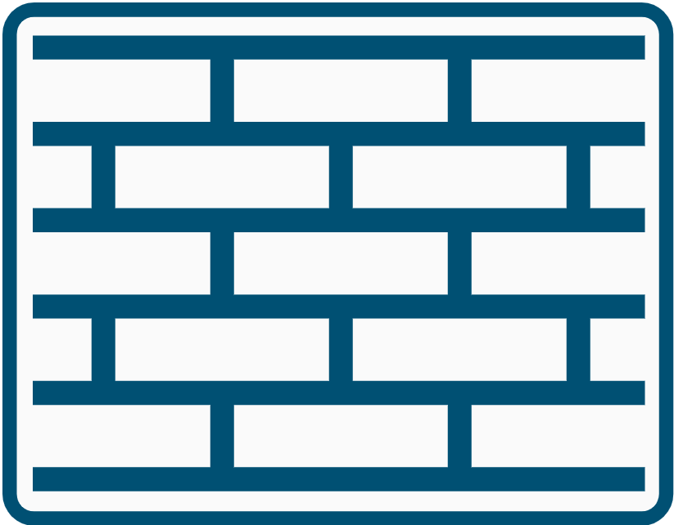



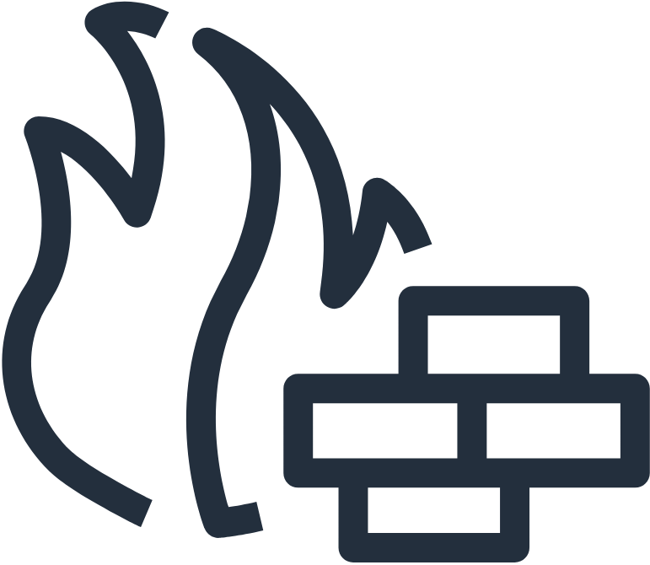












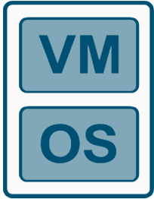
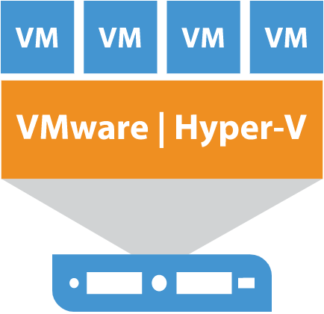
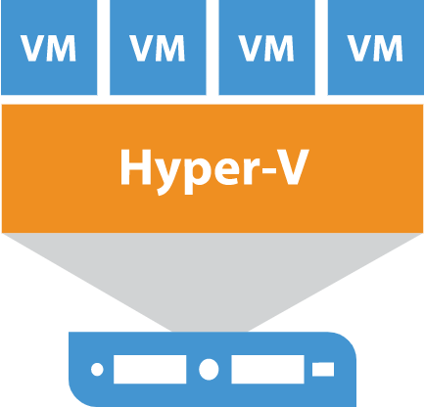
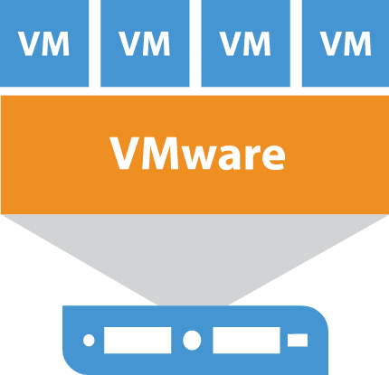







Virtual
Router
Router
Access
Switch
Leaf
Spine
L3 Switch
L2 Switch
Route 53
Balancer
GSLB
Cluster Controller
Load Balancers
L4-L7
Firewall
Route 53
Firewall
Virtual
Firewall
Security
Service
Web Application Firewall
Endpoint
Firewall
IDS/IPS
Hypervisor
Vsphere Server
Plataformas
Kubernetes

Slide 2











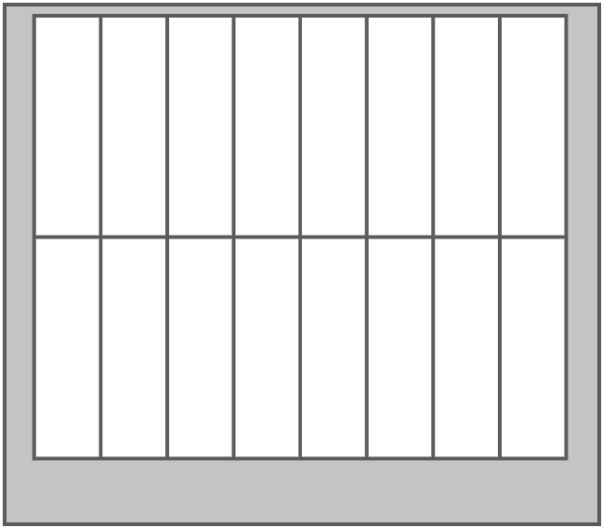

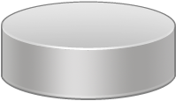


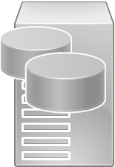

Generic
Server
Server
Farm
Web
Server
Virtual
Servers
File
Server
ToR SW
ToR SW
ToR SW
vSwitch
Hypervisor
Vmware / Hyper-V / RHVM
Blade
Enclosures
Storage
Router
Database
Fibre Channel
Fabric Switch
Fibre Channel
Storage
Storage
Array

